Slide 1


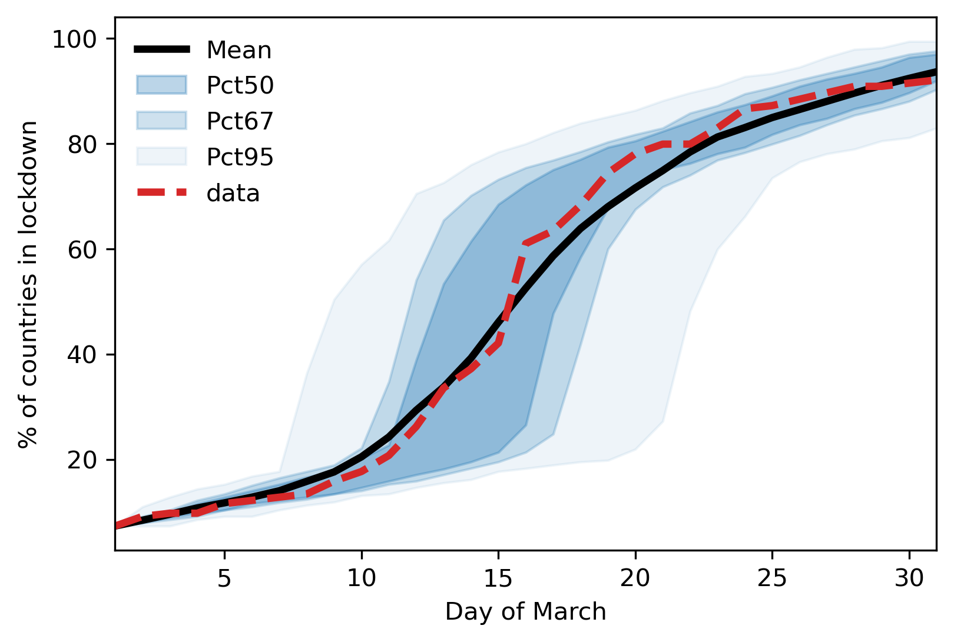
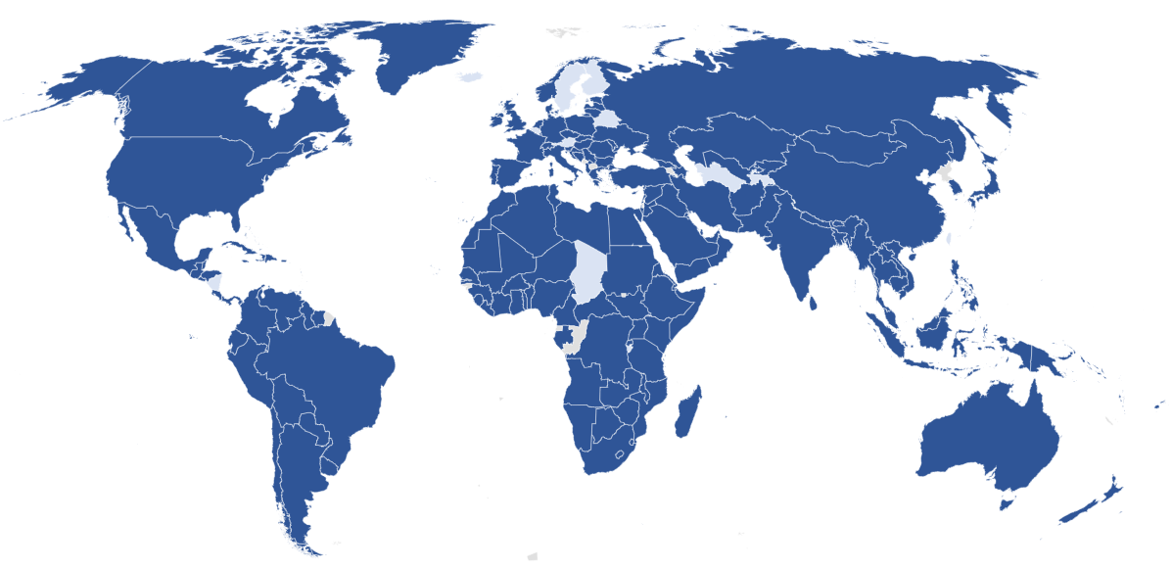

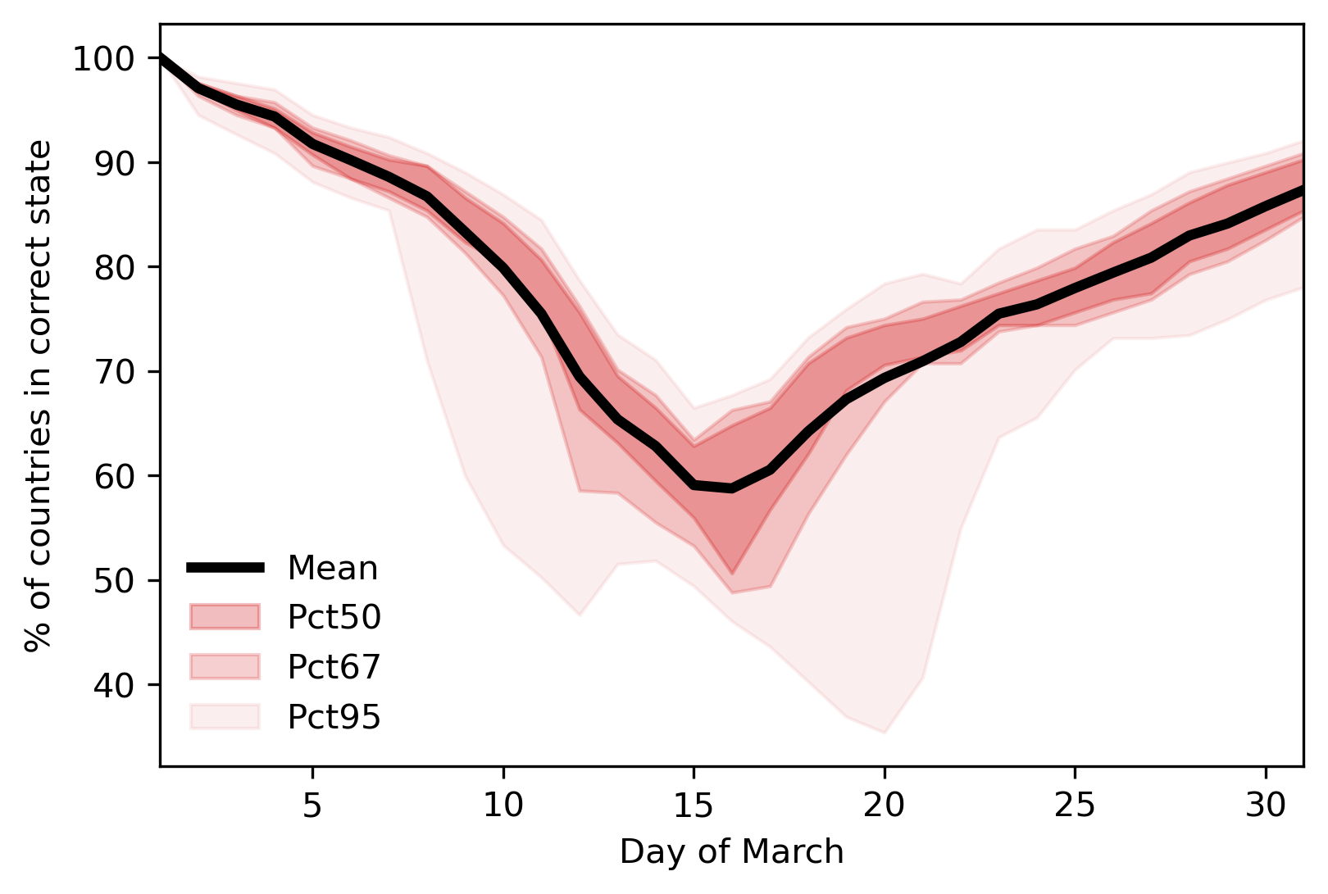
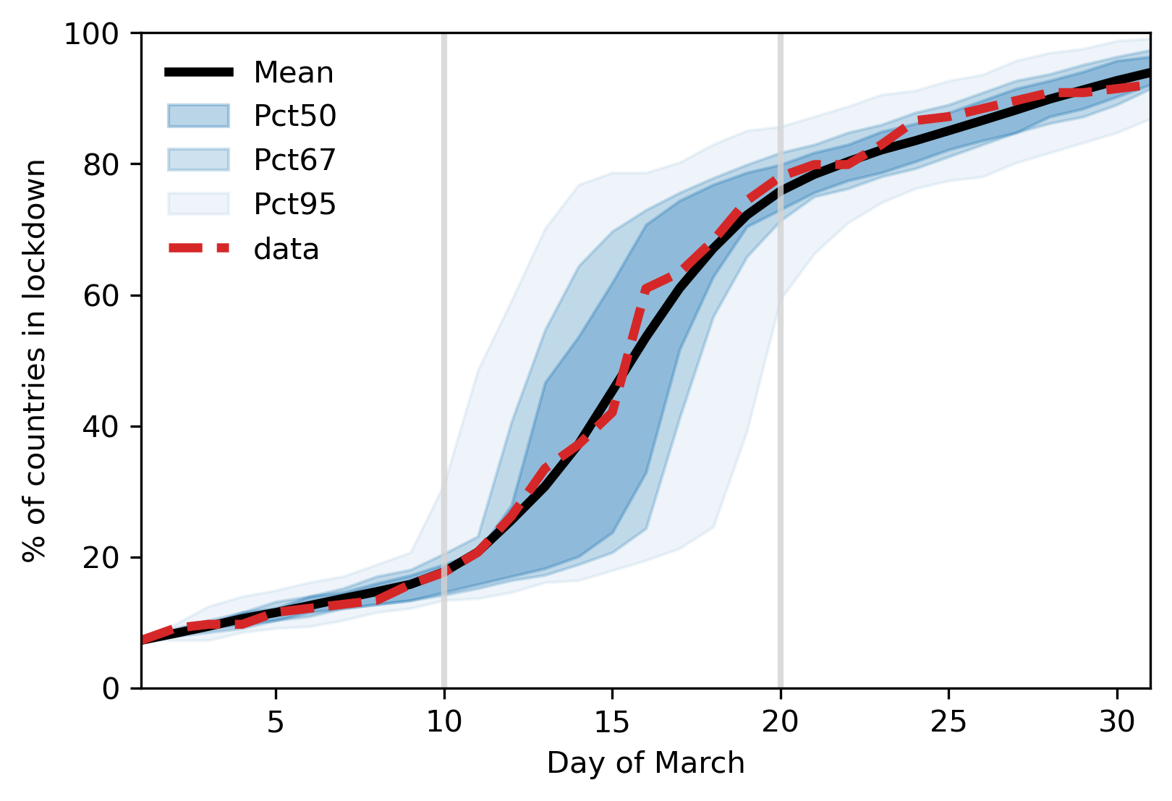
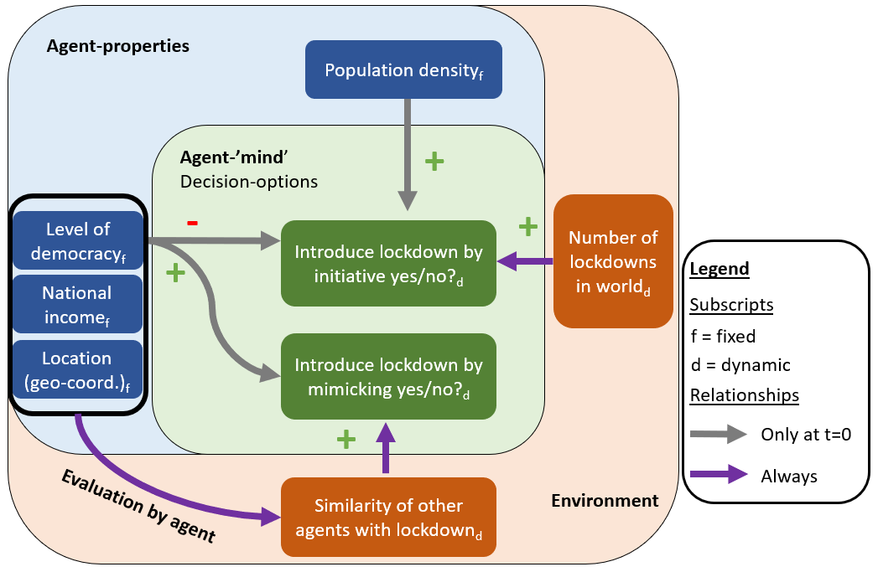
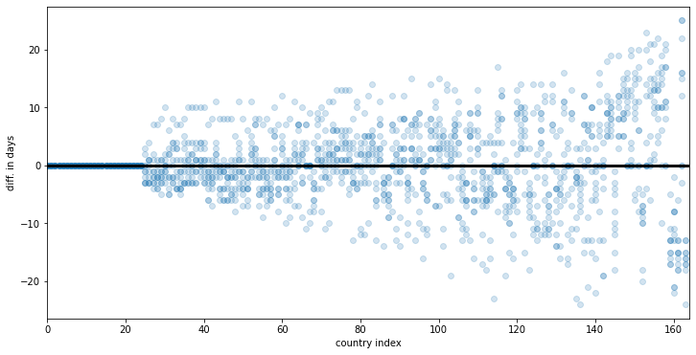
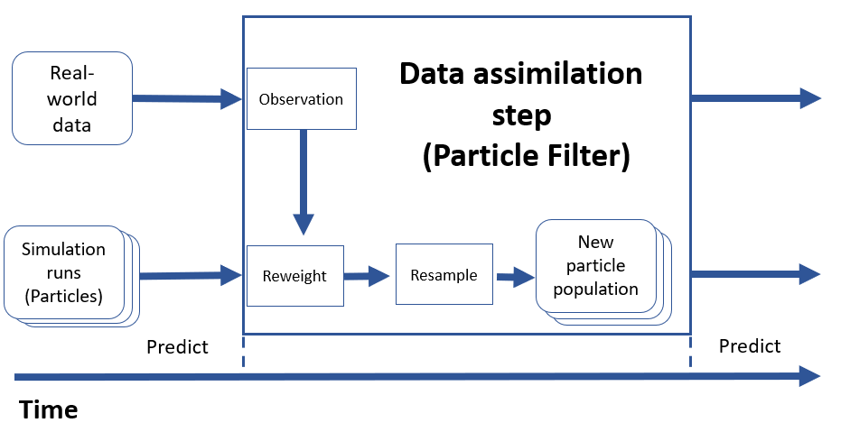
TOWARDS ANTICIPATING RAPID GLOBAL POLICY SHIFTS
An agent-based model of the 2020 tipping point in global covid policy response with integrated data assimilation
Twitter:
@yl_oswald
Yannick Oswald*, Nick Malleson School of Geography, University of Leeds
An entire world in lockdown.. How?
Results: From Macro to Micro!
Solutions to the climate crisis require global policy tipping points. But they never seem to happen. In spring 2020, during the first global wave of the COVID-19 pandemic, such a rapid policy tipping point was observed….
Experiment #1: Model base run
N = 100
Calibrated to data
Result Figure 1:
MACRO ACCURACY
We can relatively well predict the aggregate diffusion curve, or, in other words, the total number of countries in Lockdown. But the variance is high.
31st March 2020
High variance
Exponential virus spread.
But is that enough?
Result Figure 2:
MICRO ACCURACY
We struggle with predicting accurately which specific countries are in lockdown when exactly, especially during the critical transition phase!
Full lockdown
Accuracy decreases
No lockdown
Hypothesis: Countries acted like individual people. They mimicked ‘peers’.
Objective: Reproducing lockdown adoption pattern without knowledge about virus spread.
No-maths model description
The principal idea of the model is that the adoption of lockdowns across countries can be described independently of the actual COVID-case numbers across countries. The main mechanism is that the agents/countries mimic other countries that have adopted a lockdown and are similar to themselves.
Experiment #2: (Pseudo-) Particle Filter and micro-(in)accuracy
Result Figure 3+4:
The Particle Filter does reduce variance of model results and hence the reliability but does not enhance the micro-accuracy substantially yet..
Data
Assim.
Less variance
Real-time observations to make better prediction
What’s next?
Make model better, discuss with political scientist.
Study whether generalizable to climate crisis
Private jet ban?
Carbon taxes, green subsidies etc.?
Activists are right to increase ‘alarm’
(Justified) fear of the pandemic
induced the mimicking behaviour
Improve data assimilation
Climate-economic ABMs with data assimilation
Data
Your ideas?
+
Theory
=
Optimal

Slide 2


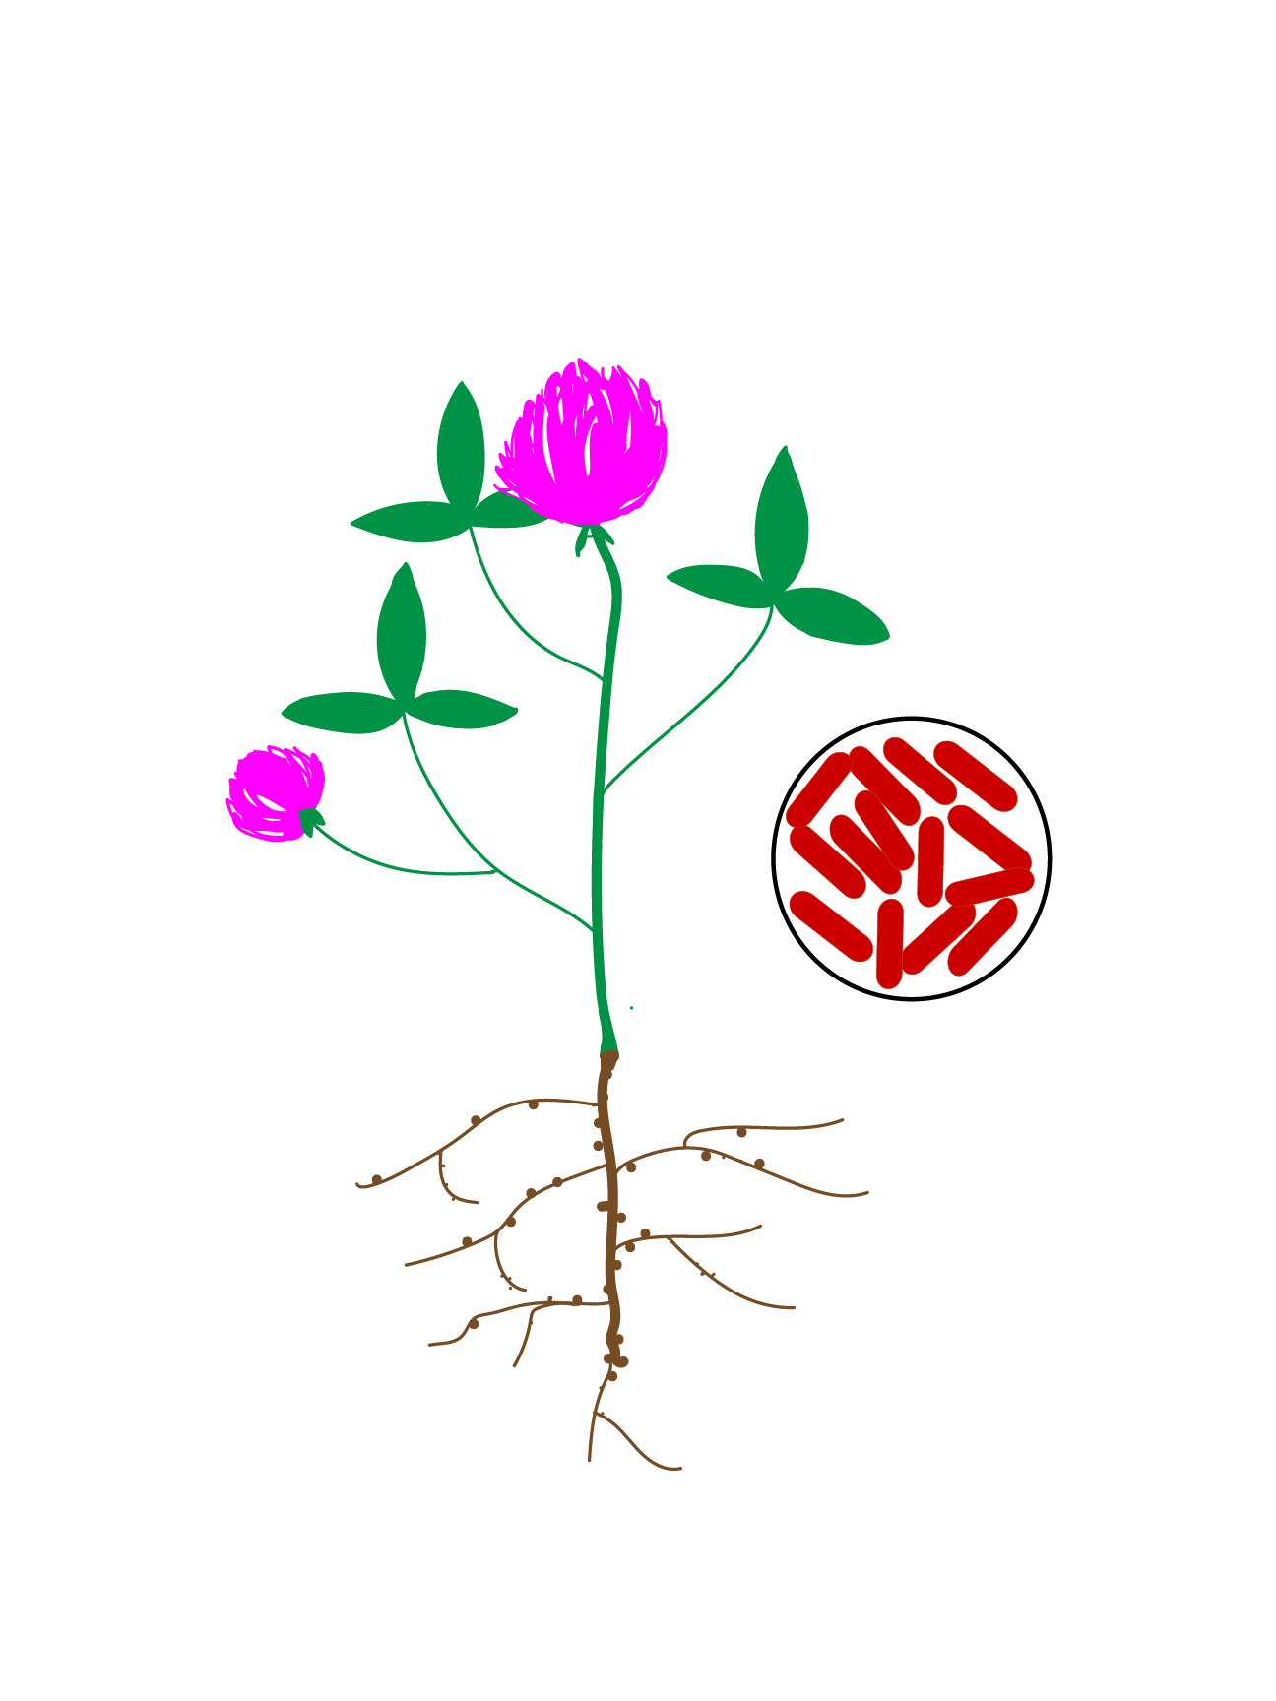
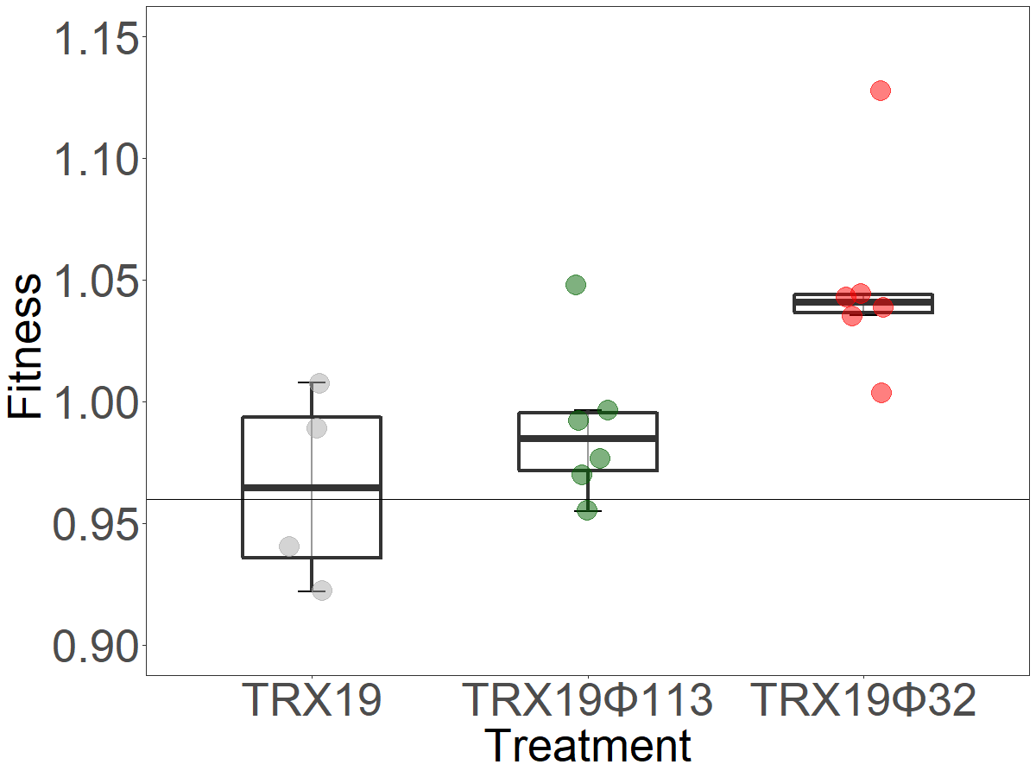
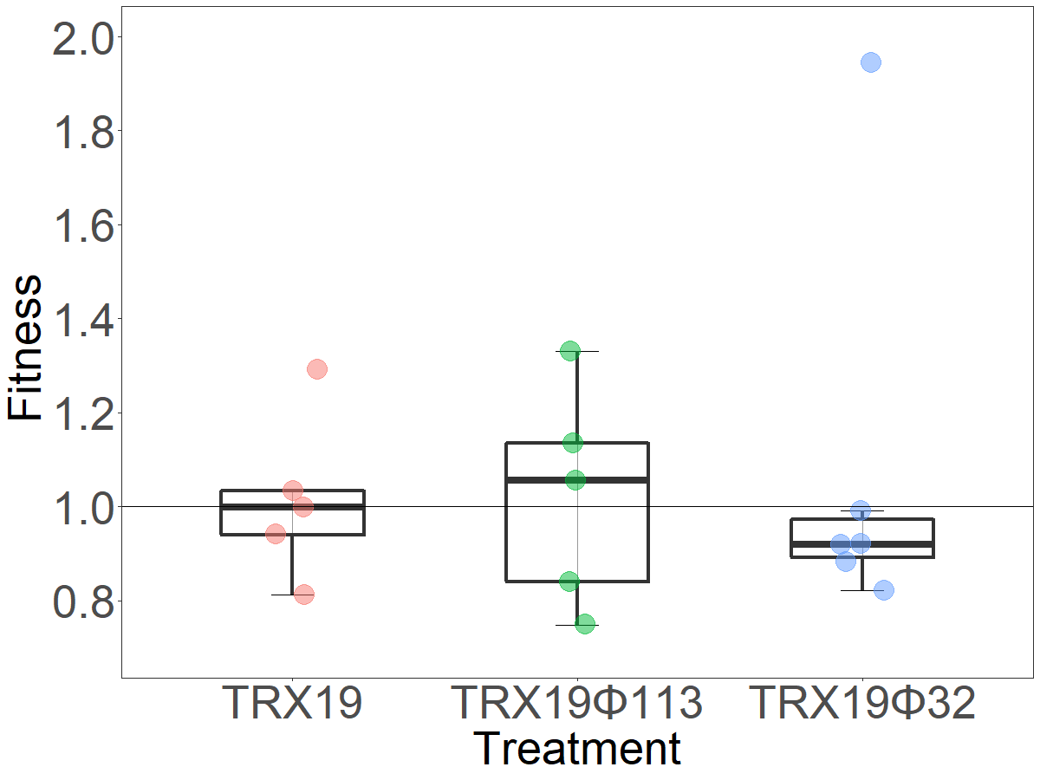
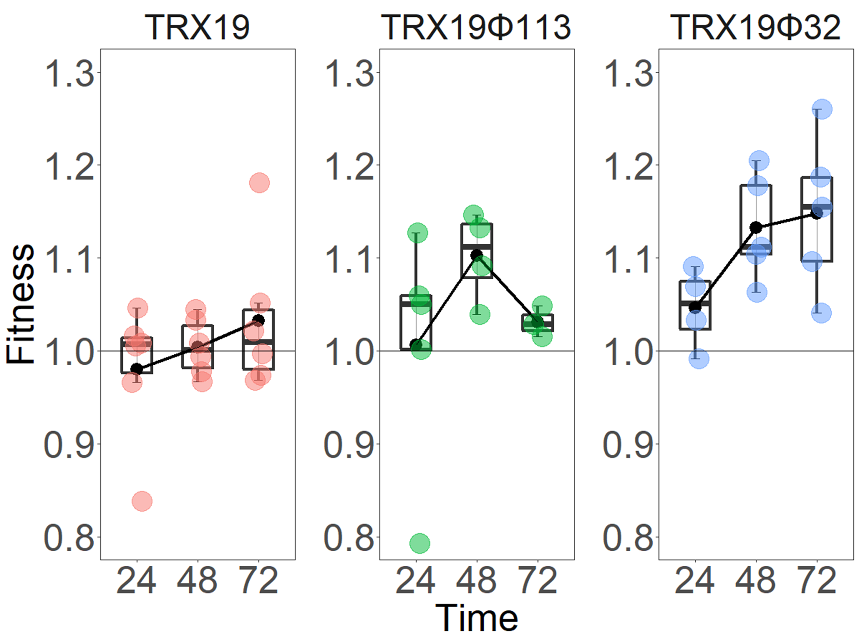
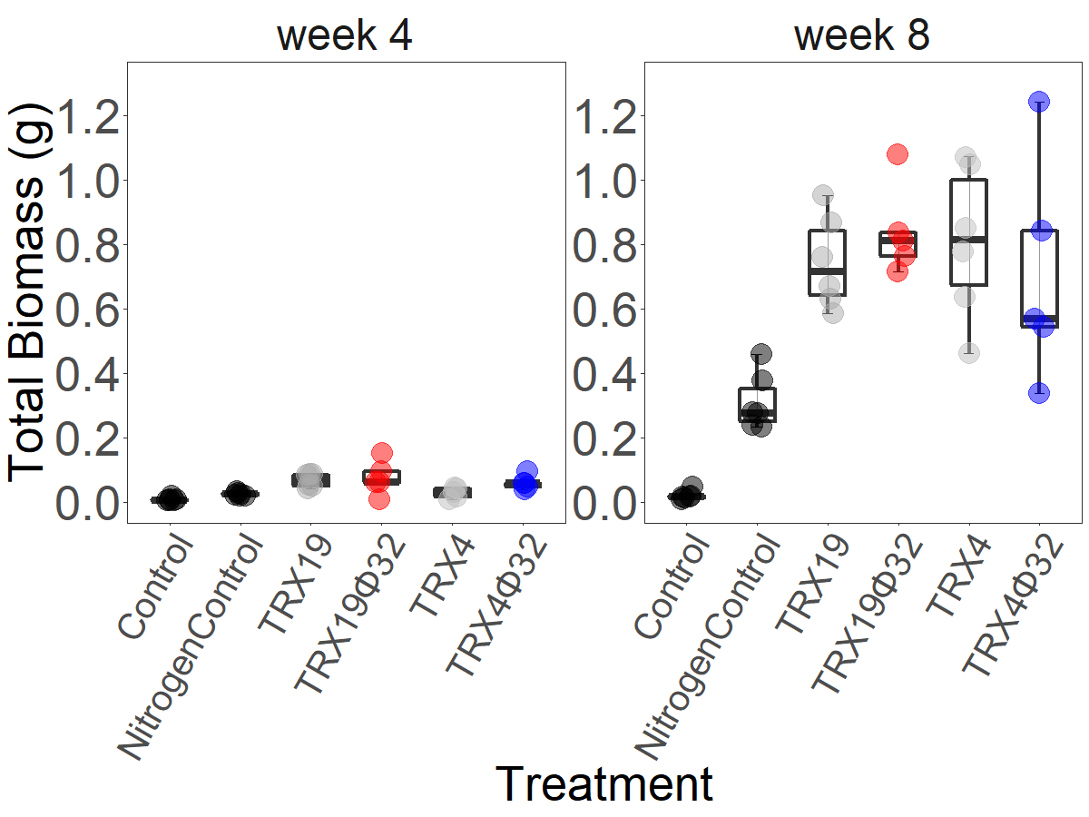
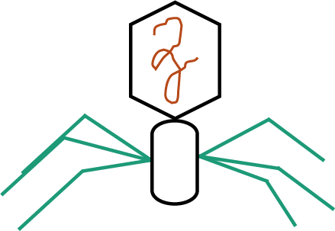
Exploring the potential of beneficial viruses to improve
rhizobia-based inoculants as nitrogen biofertilizers
Mary Eliza, Dr Ellie Harrison
School of Biosciences, The University of Sheffield
My work involves studying the potential of temperate phages to increase the competitiveness of rhizobial inoculants, also called rhizobia-based bio fertilisers.
Rhizobial inoculants as nitrogen biofertilisers
Temperate phages increase competitiveness of rhizobial strains in clover rhizosphere
Rhizobia are bacteria that form symbiotic associations with legumes. Rhizobia fix nitrogen in root organs, called root nodules, in exchange for carbon.
Rhizobial inoculants are efficient rhizobial strains that can potentially minimize or reduce fertiliser use. Yet, rhizobial inoculant use often produces sub-optimal results. One major reason for this is competition with native rhizobia for access to nodules.
In the clover rhizosphere experiment, lysogens and non-lysogens were mixed in 1:1 ratio and clover seedlings were inoculated with the mixture. The plants were harvested after 4 weeks.
TRX19 Φ 32 lysogens were competitively fitter than the TRX Φ 113 lysogens and non-lysogen controls in the clover rhizosphere.
b
a
b
Temperate phages to make rhizobia competitive
Temperate phages are viruses that infect and integrate in bacteria. These phages multiply whenever their host bacteria divide. They are also, spontaneously released as lytic phages from a bacterial cell at the onset of certain environmental conditions such as UV light.
This spontaneous release kills the surrounding susceptible bacterial populations giving lysogens – bacteria integrated with the temperate phage – resistance and a competitive advantage over bacteria without the phage.
None of the phage lysogens were significantly different and hence, competitively fitter than the non-lysogen controls in the clover root nodules.
Temperate phages increase competitiveness of rhizobial strains in vitro
Competition experiments involve two different populations competing for limited nutrients and space. The relative ratios of the two populations is used to measure competitive fitness.
Here, we measured the competitive fitness of Rhizobium leguminosarum strain TRX19 lysogens. We used temperate phages- Φ TRX 32 and Φ SM 113. We mixed TRX 19 – lysogens and non-lysogens – in equal ratios and measured the competitive fitness at 24, 48 and 72 hours.
The fitness of lysogens was compared to the fitness of a non-lysogenic control which was 1. The lysogen was competitively fit if its fitness was above 1. It was competitively unfit if the fitness was below 1.
The biomass of rhizobia inoculated plants is not affected by phage presence
Two different Rhizobium leguminosarum strains – TRX4 and TRX19 – were used to study whether the presence of phage in rhizobia affects the shoot and root dry weight (total biomass) of plants.
Clover plants were inoculated with TRX 19 and TRX 4 lysogens and non-lysogens and their biomass measured after 4 weeks and 8 weeks of growth.
b
a
BENEFIT
b
a
a
a
a
b
abc
b
c
bc
ab
ab
b
COST
The biomass of TRX4 and TRX19 lysogens as well as non-lysogen inoculated clover plants was significantly higher than the negative controls after 4 weeks.
The plant biomass was higher than the nitrogen fertilizer and the negative control treatments after 8 weeks.
Lysogens of both the phages show a fitness effect at 48 hours. This fitness effect is not seen at 72 hours as the non-lysogens are integrated by the phage and made lysogens.
Conclusion and future research
Temperate phages increase the competitive fitness of rhizobia in vitro and in the clover rhizophere. The phages used do not affect the rhizobia- clover interactions and hence, the plant biomass.
We are conducting further competition experiments to study the competitive fitness of lysogens with different rhizobial strains in vitro and in the clover rhizosphere. Experiments involve competing TRX19 lysogens with non-lysogen rhizobial strains which have differential susceptibility to phage infection.
We are also conducting competition experiments involving TRX19 lysogens and TRX19 non-lysogens which cannot be lysogenized and hence, made resistant by the phage.

